Slide 1
Business Objectives Functional Requirements Non-Functional Requirements Policies and Procedures
CPTE 443

Slide 2
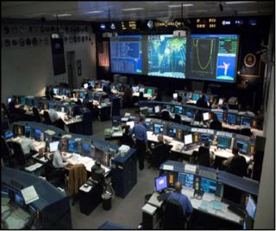
Business Objectives
An organizational goal stated in business terms
We would like to reduce operational expenses of mission control by 45%

Slide 3
Functional Requirements (Functional or System Specification)
A specification of a behavior the system must perform
The functional requirements define things you can actually do by using the software
For every functional requirement there must be an interface that allows the user to perform the action associated with the functional requirement

Slide 4
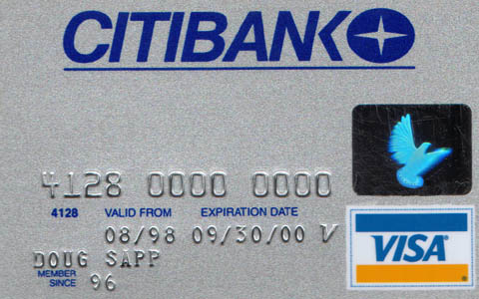
Functional Requirements
A function requirement can be stated in high level technology neutral terms
The system must support payment by credit card
Or in low level interface specific detail
The select payment type menu must have an option for Visa

Slide 5
Non-Functional Requirements (Quality Requirements)
A statement of the environment, conditions or constraints under which the system will operate, or which the system must guarantee
The average time for validation of credit cards shall be less than 10 Seconds, with the maximum time no more than 30 seconds.
The system shall encrypt credit card information before storing it.
End users have no direct way to control non-functional requirement

Slide 6
Policies and Procedures
A statement detailing necessary¹ actions outside of the hardware/software
Connection to the intranet shall only be through VPN
Expense reports shall be submitted monthly
Sales presentations shall not use Red/Green color schemes
1. To achieve business objectives

Slide 7
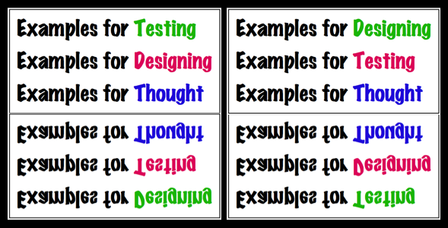
Examples

Slide 8
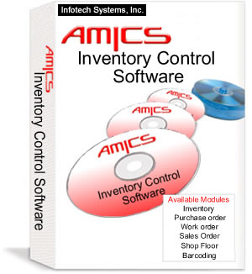
Inventory tracking
Business Objective: To prevent loss of inventory due to theft or misplaced goods. Functional Requirement: For any scanned barcode, system must be able to report quantity on hand
Quality Requirement: Database must support a minimum of 80,000 different inventory items
Policies or Procedure: All inventory is scanned into the system before leaving the loading dock

Slide 9
Online Gradebook
Business Objective: To give students and parents immediate feedback on grades. Functional Requirement:
Quality Requirement:
Policies or Procedure:

Slide 10
Goal of the Software Development?
Requirements
Software Development Process
input
output
Software System

Slide 11
Model is unrealistic for at Least 3 Reasons
input
Software Development Process
output
Requirements
Software System
First, most requirements are based on a cost benefit trade-off analysis. But until some design work is done, costs may not be knowable. In general, meaningful cost benefit analysis cannot be done without the involvement of the technical software engineering staff.
Second, most stakeholders are unaware of the capabilities of modern software systems, so they end up specifying sub-optimal systems based on limited knowledge.
Third, and perhaps most importantly, humans are notoriously incapable of specifying in the abstract.

Slide 12
Role of Software Developers Relative to Requirements
Give the product owner best possible cost and time estimates so the owner can calculate ROI
Brainstorm with the product owner about product possibilities
Frequently demonstrate small units of business functionality, so the owner can make adjustments to the current implementation in a timely manner and better envision future features

Slide 13
A More Realistic Model
Business Goals
Software Development Process
input
output
Code
Requirements
Design
Software System
input

Slide 14
Role of the Software Development Team?
Business Goals
(Definition of what would provide value)
input
Software Development Process
output
Code
Requirements
Design
input
Software System
(Realization that provides value)

Slide 15
Homework
Create a word document that for two of the three sample Business Objectives gives a corresponding:
Functional Requirement
Non-functional Requirement
Supporting Policy or procedure

Slide 16
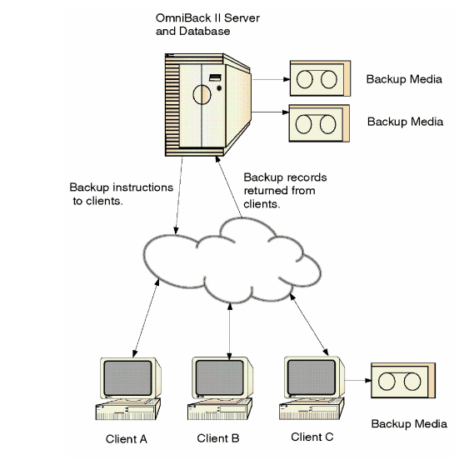
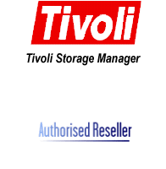
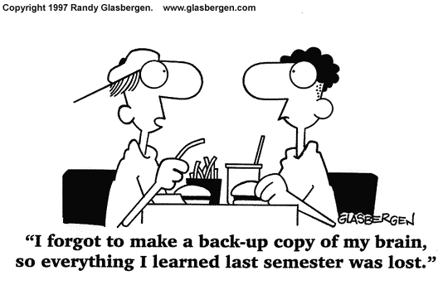
Data Redundancy
RAID
Business Objective: To be able to recover data and resume operations in a timely
manner after a hardware, software, or user failure, we are going to put a backup solution in place

Slide 17
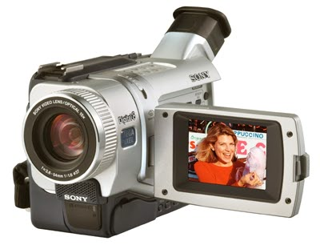
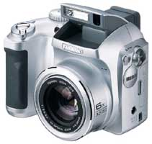
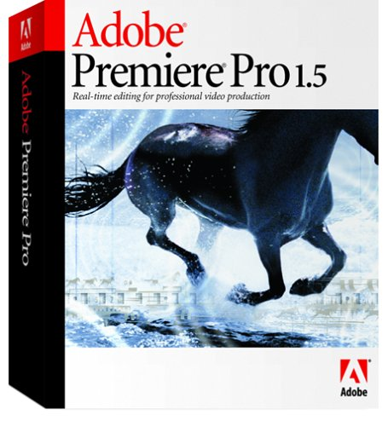
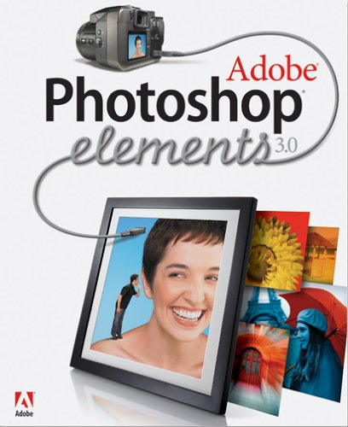
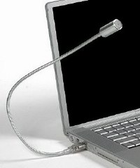
Media support
Business Objective: To be able to more effectively communicate ideas both
internally amongst employees and externally to potential clients and business partners we are going to purchase a media manipulation software suite.

Slide 18
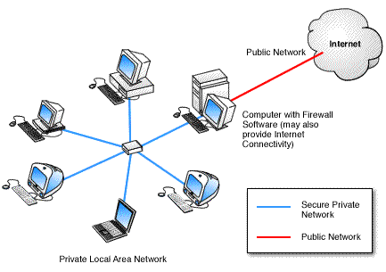
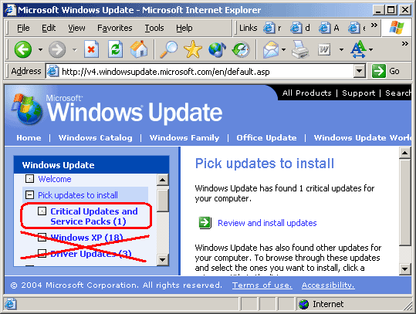
Security
Business Objective: To prevent disruption of business functions, and theft of
business data by external individuals we are going to purchase firewall software/hardware

Slide 19
The End

